Slide 1

AMRUTVAHINI COLLEGE OF ENGINEERING,
SANGAMNER
DEPARTMENT OF COMPUTER ENGINEERING
2024-2025
Presentation
On
“BlockShare - Blockchain Based Secure Data Sharing Platform”
BE Computer Engineering
BY
Group Id- B-06
Mr. Abhijit Rajaram Sahane (4228)
Mr. Shinde Rohit Nivrutti (4240)
Mr. Sayyad Mohammadsaani Shahid (4234)
Guided by: Project Coordinator: H.O.D
Ms. K. U. Rahane Dr. D. R. Patil / Dr. R. G. Tambe Dr. S. K. Sonkar

Slide 2
BlockShare Blockchain based data sharing platform
In the digital age, the security and privacy of shared data has become a concerns. Traditional data sharing systems often rely on centralized servers, which are susceptible to hacking, data breaches, and unauthorized access. This project aims to develop a block chain based secure data sharing platform that leverages the decentralized nature of blockchain technology to enhance data security and privacy.

Slide 3
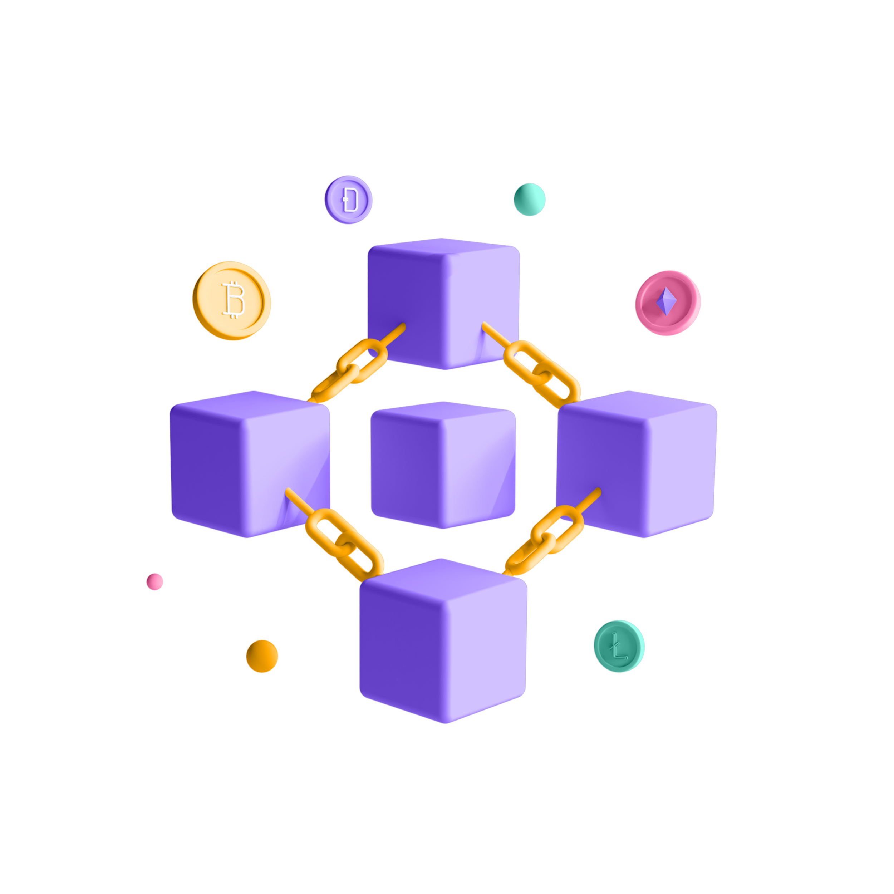
Area
Data Security.
Blockchain Technology.
Decentralized System.
Smart Contracts.

Slide 4
Abstract
In today's digital world, sharing data online is common but often faces issues like privacy, security, and high costs. By using blockchain technology, we can solve these problems. Blockchain removes the need for middlemen, reducing fees and speeding up transactions. It also provides secure, decentralized data storage, strong access control, and reliable identity verification, making it a powerful solution for safe and efficient data sharing.

Slide 5
Literature Survey
Blockchain-Empowered Trustworthy Data Sharing Fundamentals, Applications, and Challenges : Pengyong Cao , Guijiang Duan, Jianping Tu Qimei Jiang Xianggui Yang and Chen Li.(2023)
A Survey of Blockchain-Based Schemes for Data Sharing and Exchange. : Rui Song , Bin Xiao , Senior Member, Yubo Song , Songtao Guo ,and Yuanyuan Yang.(2023)
Blockchain-Based Process Quality Data Sharing Platform for Aviation Suppliers. Pengyong Cao, Guijiang Duan, Jianping Tu Qimei, Jiang Xianggui Yang and chen li.(2023)
A Consent Model for Blockchain-Based Health Data Sharing Platforms. Vikas Jaiman and Visara Urovi. (2020)
Subscription-Based Data-Sharing Model Using Blockchain and Data as a Service :Fahad Ahmad Al-Zahrani.(2020)

Slide 6
Objectives:
To understand the basics of blockchain and how blockchain works.
To understand the security concepts related with blockchain.
To implement smart contracts to automate and secure data access control.
To create a decentralized system to eliminate the need for a central authority.
To develop a secure data sharing platform utilizing blockchain technology.

Slide 7
Scope Of The Project
Implement secure user authentication mechanisms to ensure only authorized users can access the platform.
Encrypt data before storing it on the blockchain to protect sensitive information from unauthorized access.
Use smart contracts to manage and enforce access control policies on the platform.
Facilitate secure and decentralized data sharing through blockchain technology.
Maintain immutable audit trails to track and verify all data access and sharing activities on the platform.

Slide 8
Software requirements
Operating System - Windows 7/8/10 / Linux / Mac.
Front-end Frameworks - React.js ,Tailwind CSS.
Decentralized platform - e.g.(Ethereum).
File Storage – IPFS File Storage
API -e.g.( web3.js ,ether.js).
Programming Languages - Solidity ,JavaScript.

Slide 9
Hardware requirements
Ram : 8GB
Rom : 256 GB SSD
Processor : 3.0 GHz

Slide 10
Thank You…

